Slide 1

Corpus Presenter
─ Additional Utilities ─
Raymond Hickey
www.raymondhickey.com
Notes:
1

Slide 2
Additional Utilities
The Corpus Presenter suite contains a number of other programs which are designed to assist users in their day-to-day work with corpus data.
They complement options of the Windows operating system by providing additional functionality which might be of help to users.
Please check out the supplied file manager, which will do incremental backups of your data so that you never lose anything; it also contains a host of powerful options (see the two screenshots at the end of this tutorial).

Slide 3
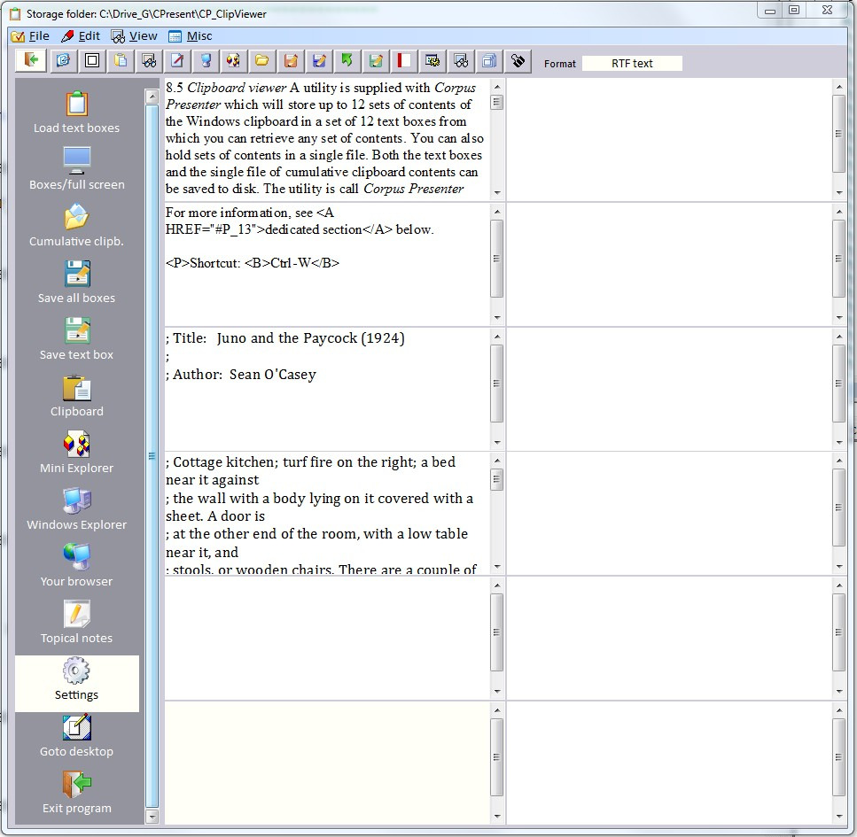
CP Clipboard Viewer
This utility will keep the contents of up to 12 instances of the Windows clipboard in text boxes (note: Windows only holds one set of data at a time).
You can save the text boxes to disk if you wish.

Slide 4
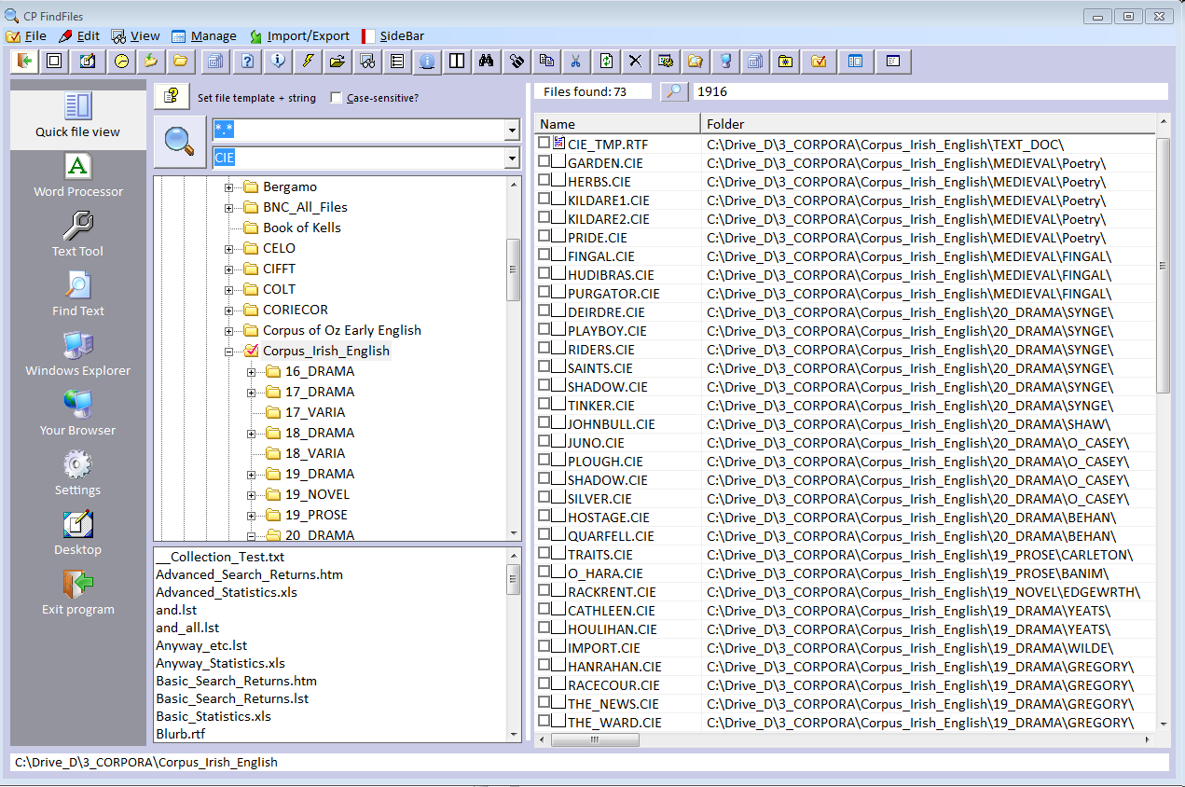
CP Find Files, a flexible tool for locating any files on your hard disk

Slide 5
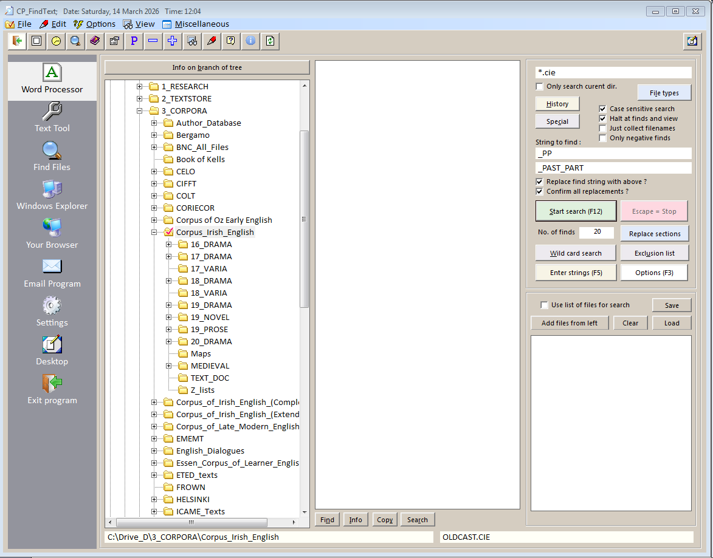
CP Find Text, a tool to find (and replace) any text in any set of files

Slide 6
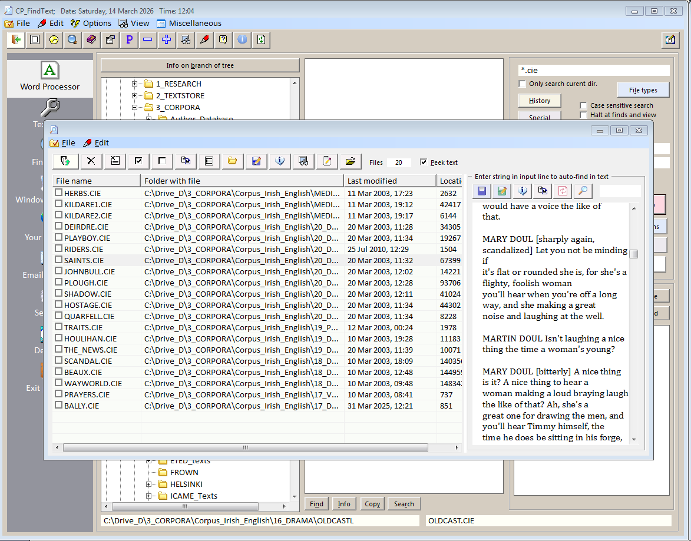
CP Find Text can be useful when preparing and normalising corpus texts

Slide 7
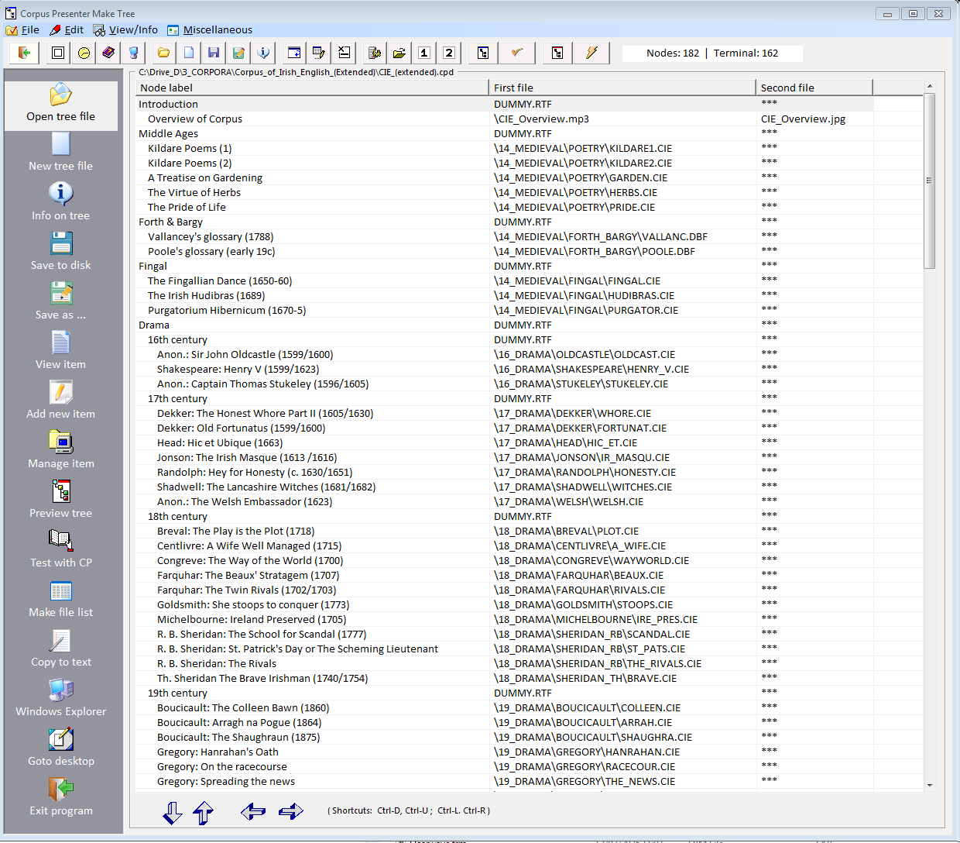
CP Make Tree
Here you can edit the control file for a corpus (with the extension .CPD). Or you can easily design your own corpus tree which can then be used with Corpus Presenter.

Slide 8
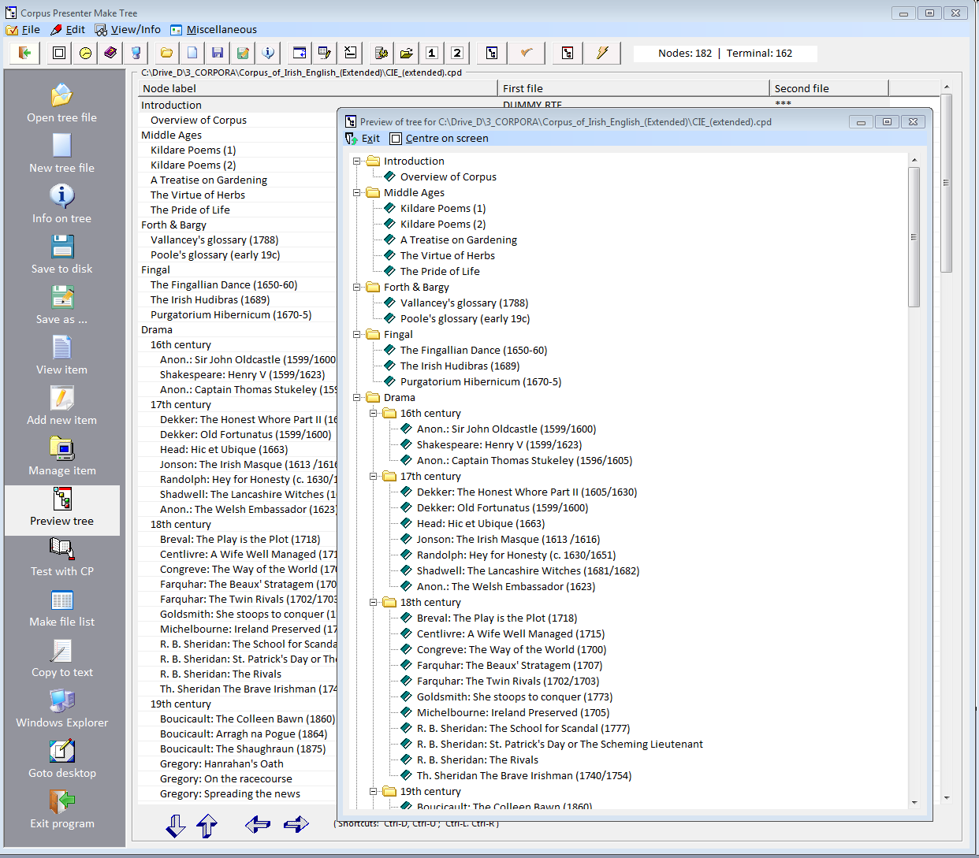
CP Make Tree
At any stage when working with this program you can preview the tree you are making/ editing. It is then shown as it will appear in Corpus Presenter.

Slide 9
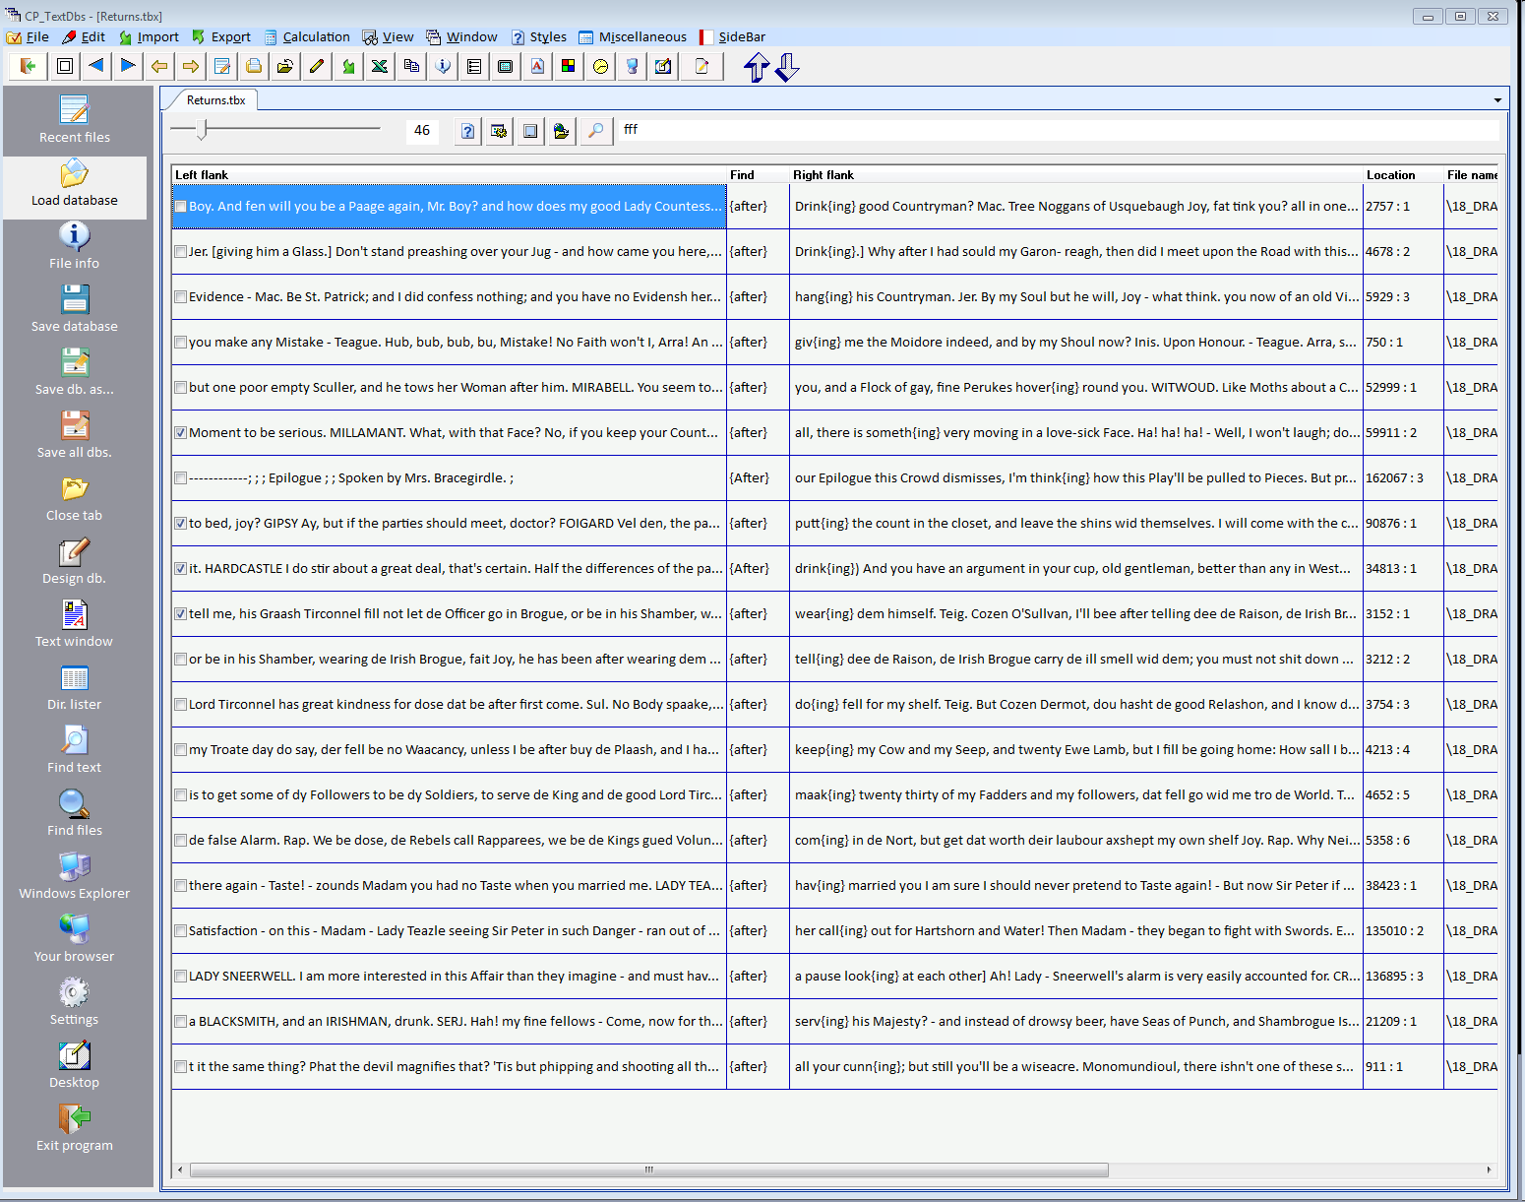
CP Text Databases
This utility allows you to edit the output of a search from within Corpus Presenter. You can maintain many sets of returns in this way and process them later as you wish.

Slide 10
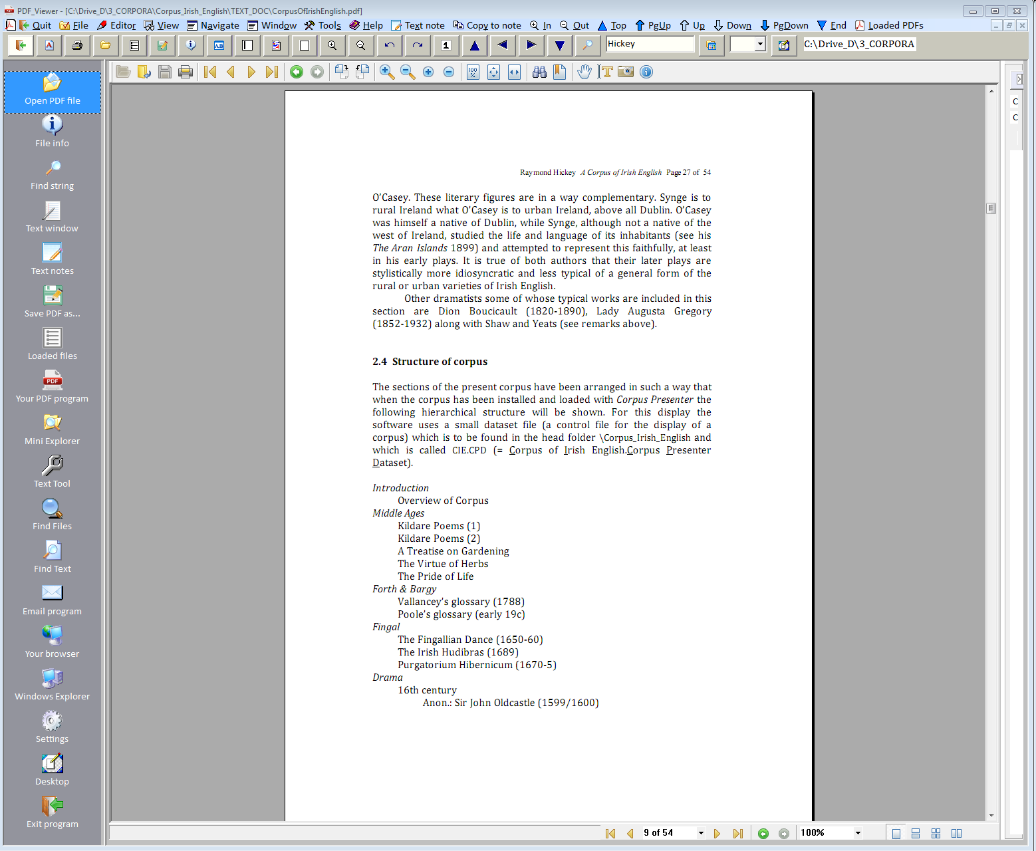
PDF Viewer
This is a flexible utility for viewing PDF files. It has an inbuilt text editor with which you can process any text copied out of a PDF.

Slide 11
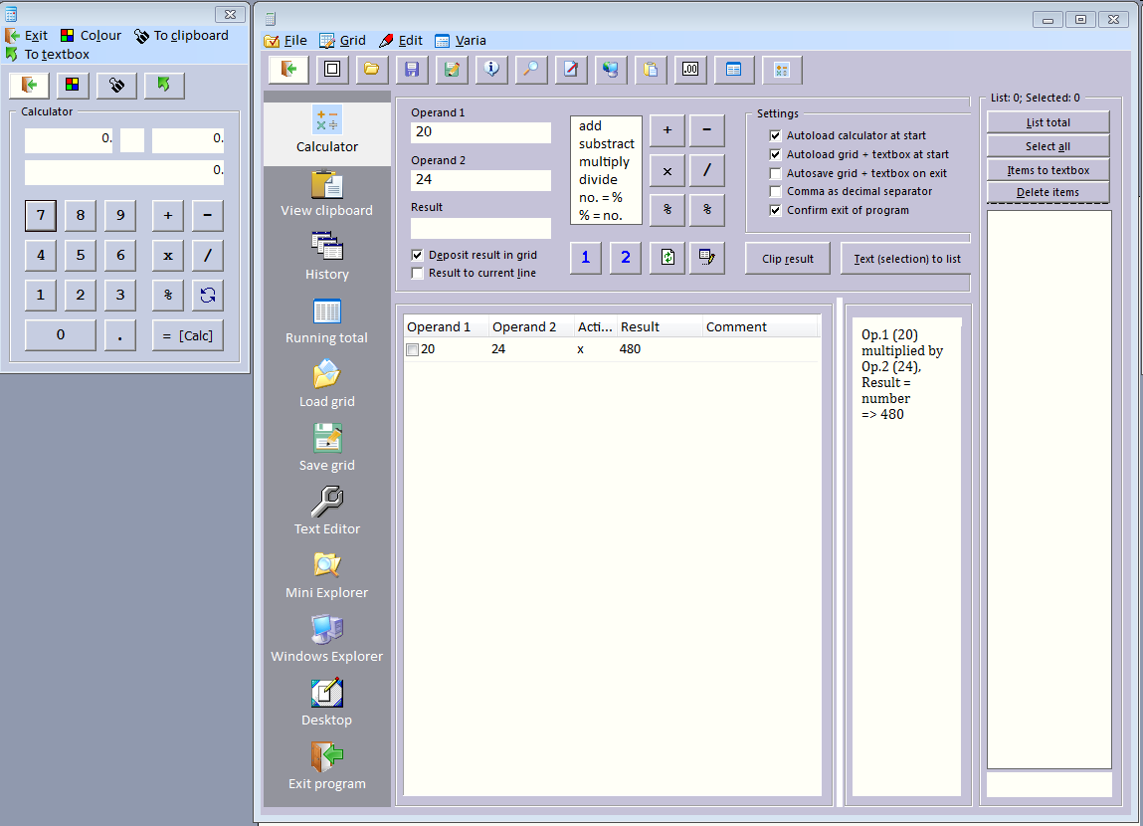
CP Calc, a flexible calculator with which you can perform and then save any calculations

Slide 12
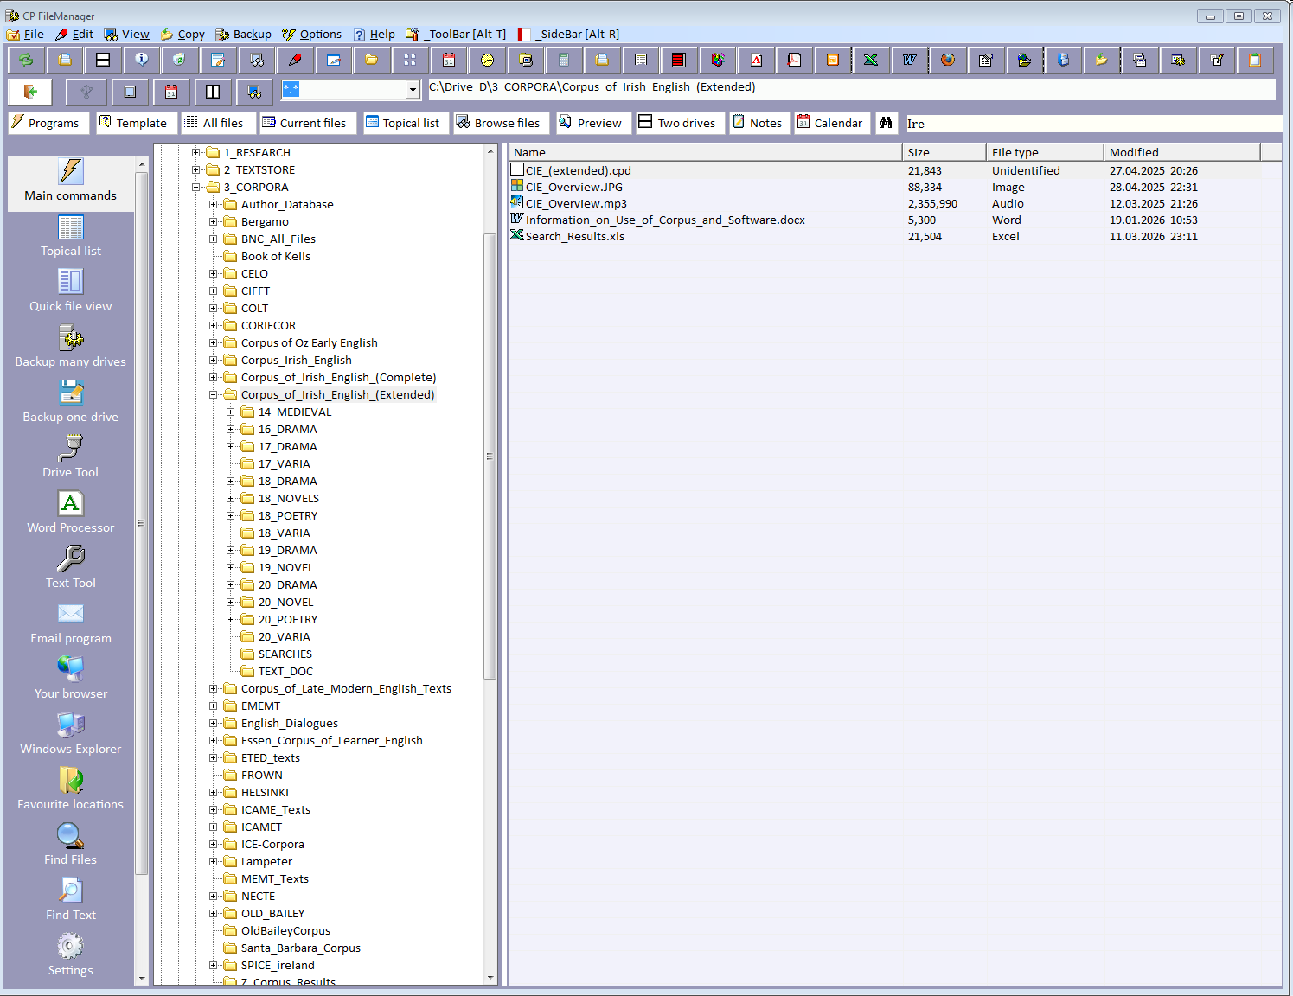
CP File Manager : opening screen

Slide 13
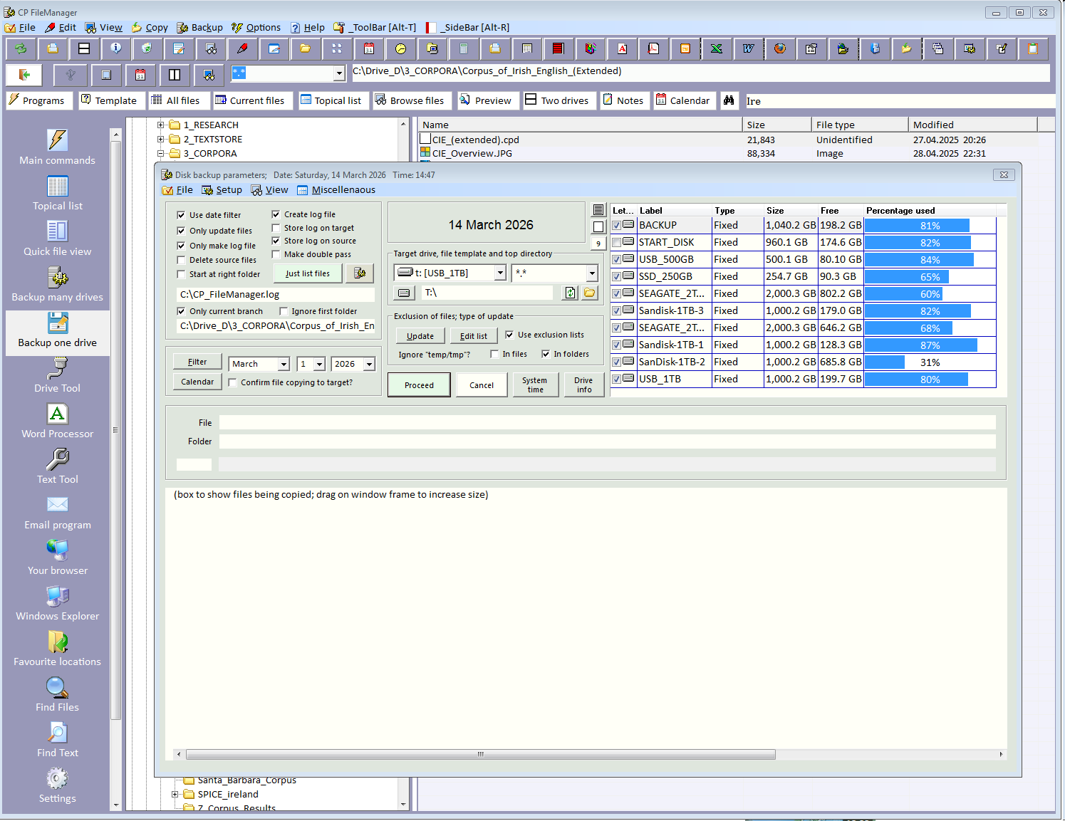
CP File Manager : backing up data files to external disks

