Slide 1

Corpus Presenter
─ Pre- and Postprocessing of Texts ─
Raymond Hickey
www.raymondhickey.com
Notes:
1

Slide 2
Pre- and Postprocessing of Texts
The Corpus Presenter suite contains a number of programs, apart from the main one, which may be of interest to users as they can perform many functions particular to corpus linguistics.
For the pre- and postprocessing of texts the two relevant programs are the following:
CP Text Tool ─ a flexible text editor with which you can prepare texts for analysis with Corpus Presenter. Note that a text editor is intended for processing unformatted text and can be useful when tagging texts in advance of analysis, for example.
CP Word Pro ─ a powerful word processor with which you can format and arrange any output data from an operation carried out by Corpus Presenter. The program can process files in RTF, Microsoft Word or HTML formats, as well as plain text files. The word processor has many additional options which would make it suitable for writing and editing any text files you might have.

Slide 3
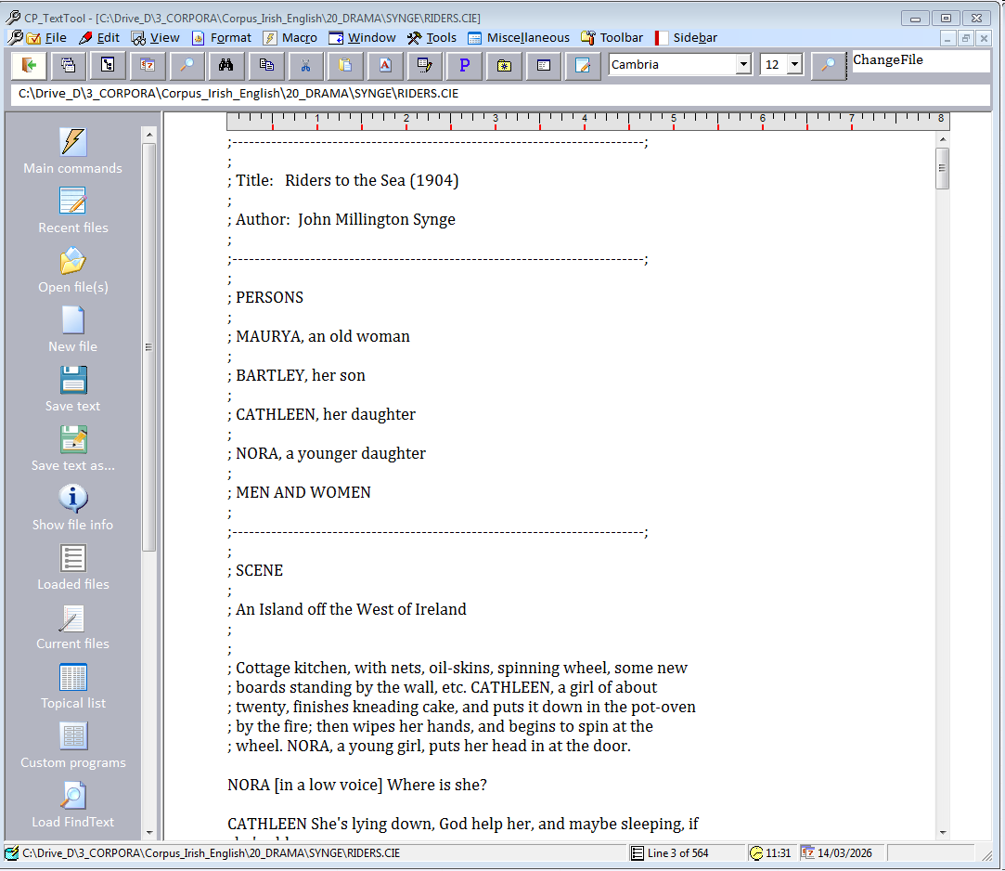
The supplied text editor: CP Text Tool

Slide 4
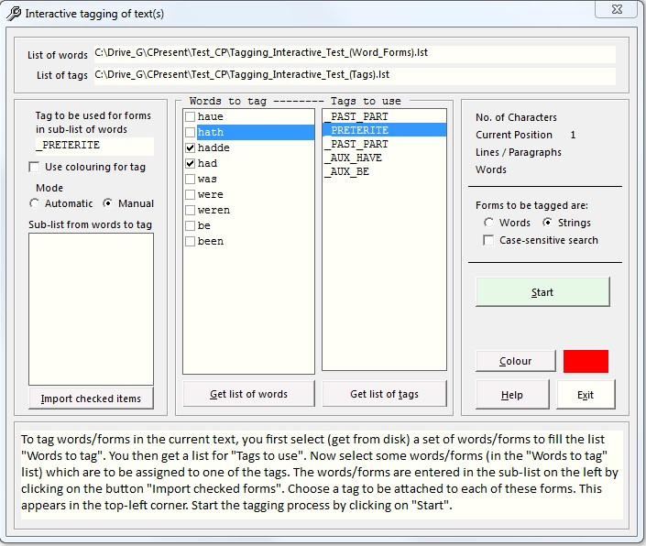
Preprocessing example: tagging texts with CP Text Tool

Slide 5
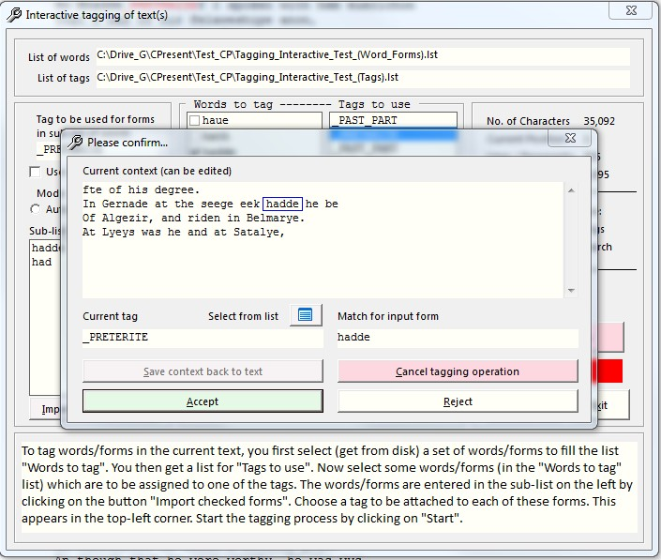
Preprocessing example: tagging texts with CP Text Tool

Slide 6
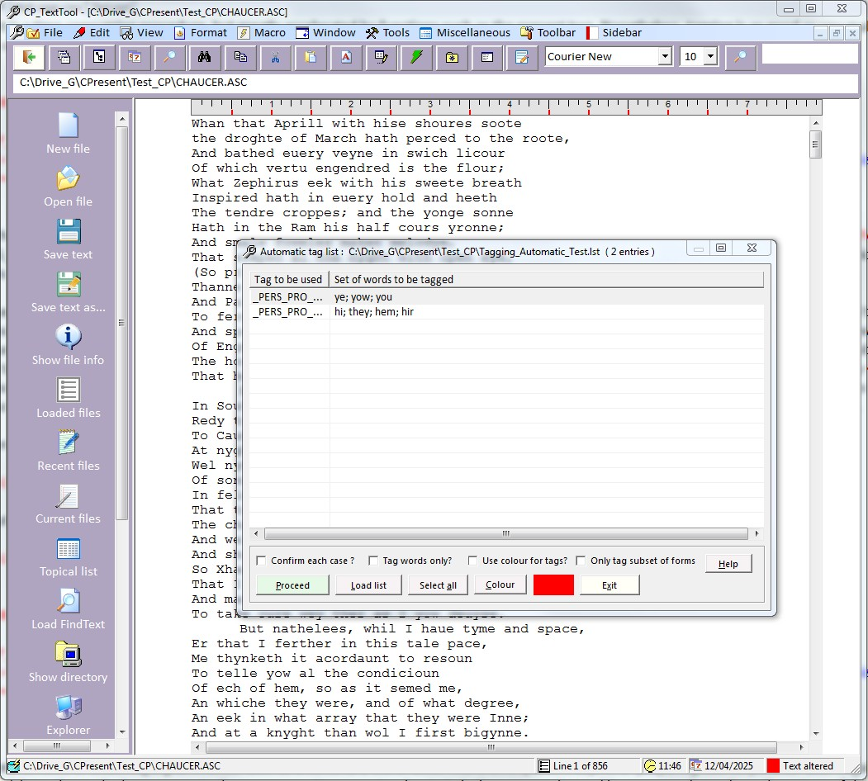
Preprocessing example: tagging texts with CP Text Tool

Slide 7
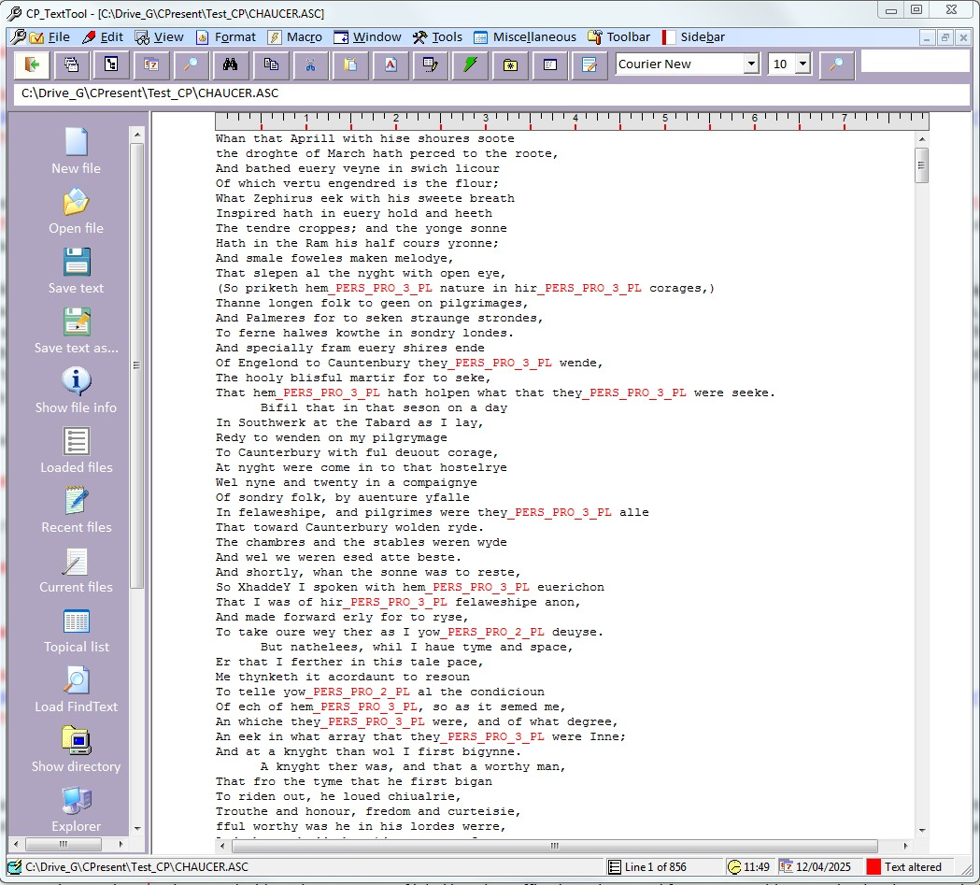
Preprocessing example: tagging texts with CP Text Tool

Slide 8
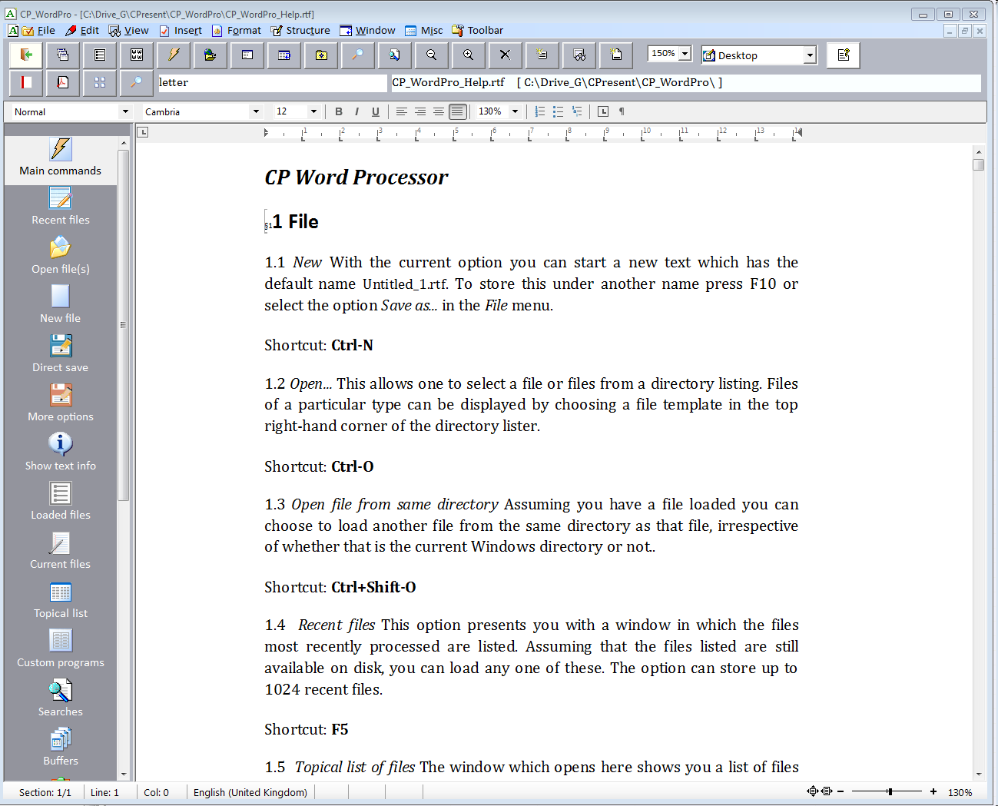
The supplied word processor: CP Word Pro

Slide 9
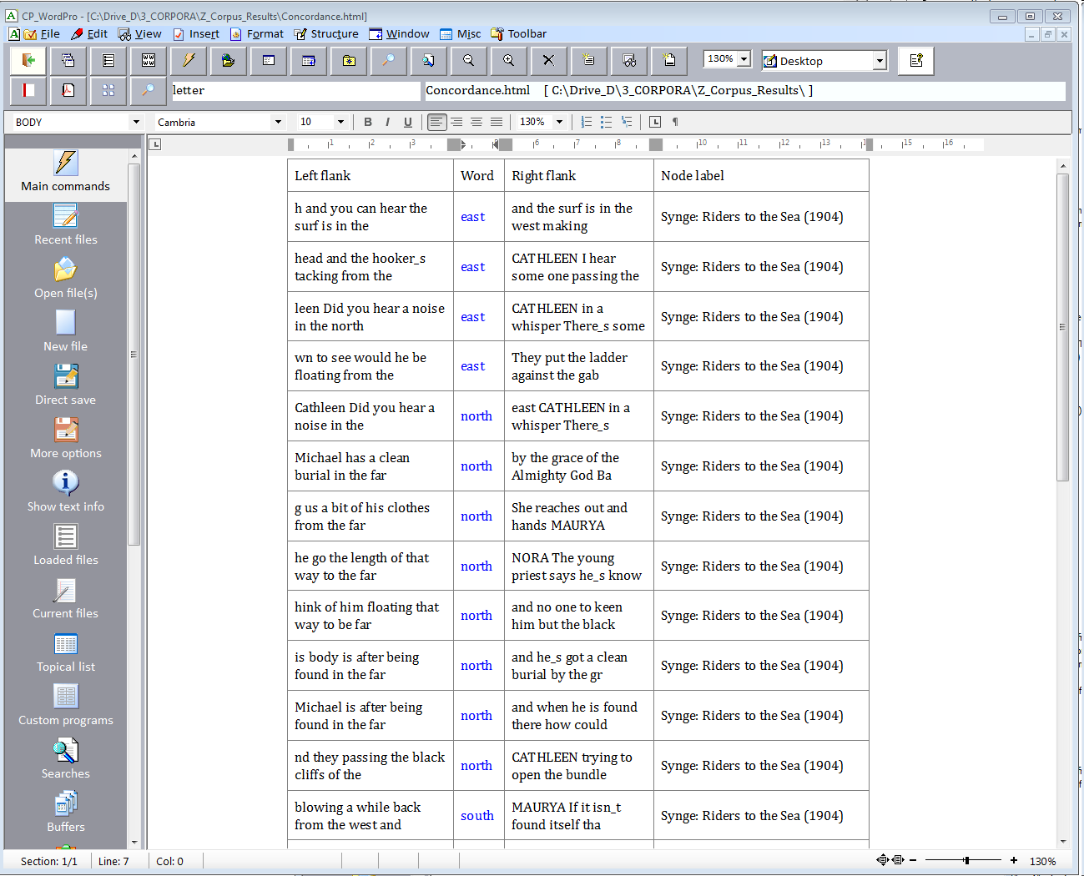
Postprocessing example: formatting tables of data with CP Word Pro

