Slide 1

Corpus Presenter
─ Sample Tasks ─
Raymond Hickey
www.raymondhickey.com

Slide 2
Lessons to be learned from corpus linguistic tasks
I will begin this presentation by discussing the insights to be gained from corpus linguistic tasks (before proceeding to the actual tasks) and mention the caveats which users (scholars/students) must keep in mind.
1) Computer text corpora can be very useful in quickly determining whether and to what extent certain words or grammatical structures occur in the textual record (historical documents) of a variety or language.
2) Users of such corpora must always check the returns from searches and remove spurious instances and recalculate the statistics to ensure that the latter are as accurate as possible.
3) The interpretation of corpus linguistic results rests solely with the user. A computer can – and usually will – offer statistics which will lead users to a robust analysis of the data they are considering. In fact, one must often revise notions one has had about data after seeing the results of corpus linguistic searches (see Task 2 below).

Slide 3
Sample tasks with Corpus Presenter
The sample tasks shown here all concern developments in the history of Irish English. They use A Corpus of Irish English, which can be downloaded from the same website as Corpus Presenter. This corpus can be used straight away with Corpus Presenter by installing it and then simply loading the control file CIE_(extended).cpd at the very beginning of a work session with Corpus Presenter.
If you are interested in any issues discussed here, you can consult the online Irish English Resource Centre (accessible at www.raymondhickey.com). This resource contains much information on Irish English and is entirely open access, so it can be used by students and scholars alike (no registration required).
If you appreciate reading books, you might like to consult the following for more detailed discussions of matters concerning Irish English:
Raymond Hickey 2007. Irish English. History and Present-day Forms. Cambridge: Cambridge University Press.
Raymond Hickey (ed.) 2024. The Oxford Handbook of Irish English. Oxford: Oxford University Press.

Slide 4
Sample tasks with Corpus Presenter
Please bear in mind:
The following tasks illustrate how you can go about tackling a linguistic question with a corpus of texts. The points dealt with in each task are by no means exhaustive – they are simply intended to show you what you can do with the Corpus Presenter software. When doing a task yourself, you would go through many searches, comparing results at each stage and refining your parameters to gain maximum insights from your corpus investigation.

Slide 5
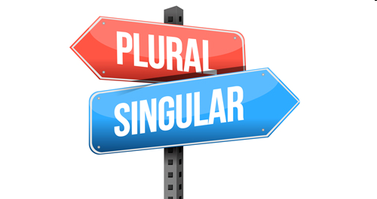
Task 1: Forms of the second person plural pronoun

Slide 6
Task 1: Forms of the second person plural pronoun
One of the remarkable features of standard English today is that its does not have a distinction between second person singular and plural among pronouns. However, all the Germanic languages, with which English is closely related, and all the other Indo-European languages, such as the Romance, Slavic or Celtic languages do have such a distinction.
So what happened? In the early modern period (especially during the 17th and 18th centuries) English lost the singular form thou (= Germanic du, Romance tu) and came to use you for singular and plural.
On the other hand, the non-standard varieties of English retained a means of distinguishing singular and plural by developing some means of expressing the second person plural which was not present in the standard. A number of these forms, above all youse and yeez, would seem to be Irish in origin as one can show by examining corpora from the history of English.

Slide 7
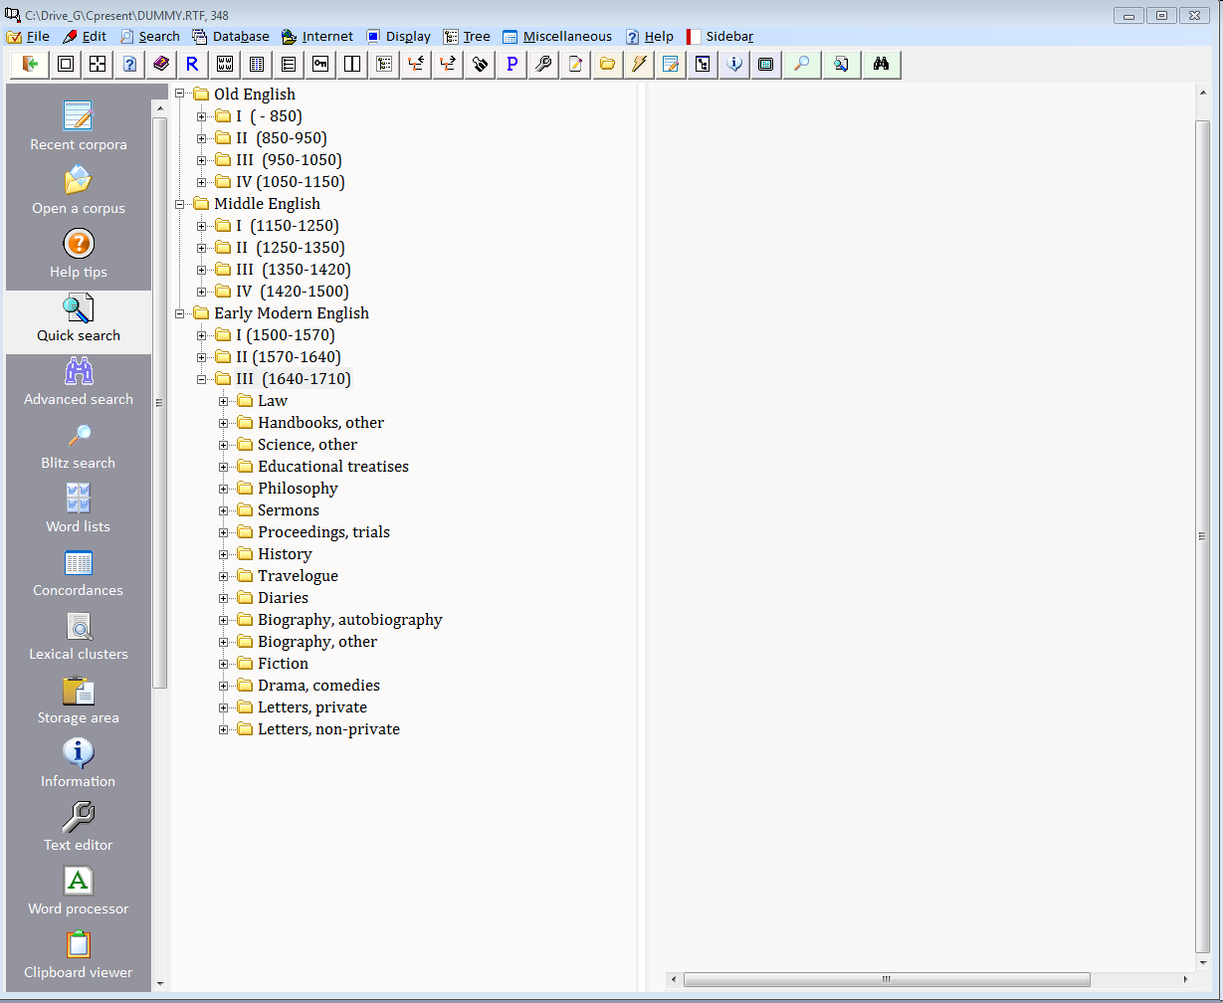
The Helsinki Corpus of English Texts; here: the third branch of Early Modern English (1640-1710)

Slide 8
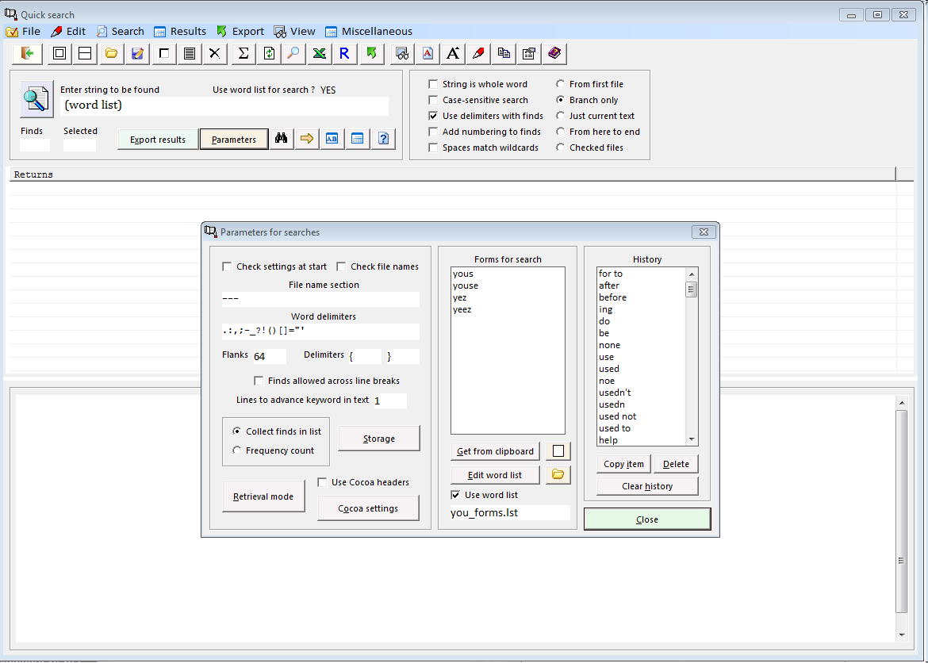
Searching for non-standard second person plural pronouns (using a prepared word list) in the Helsinki corpus; result: not a single find.

Slide 9
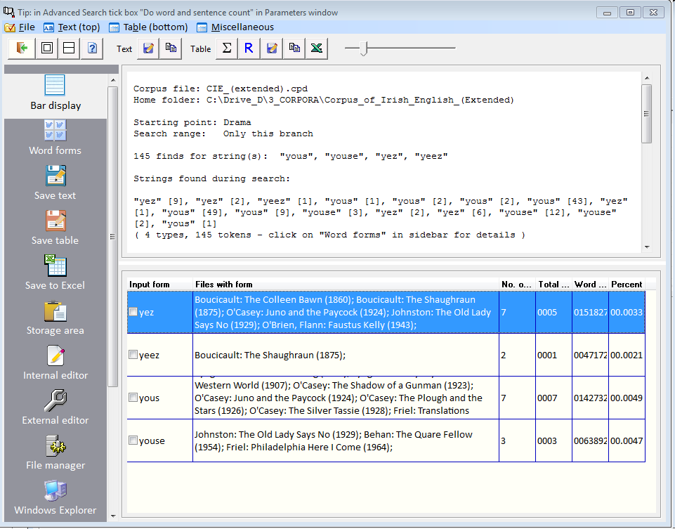
Finds for non-standard second person pronouns over the centuries in A Corpus of Irish English

Slide 10
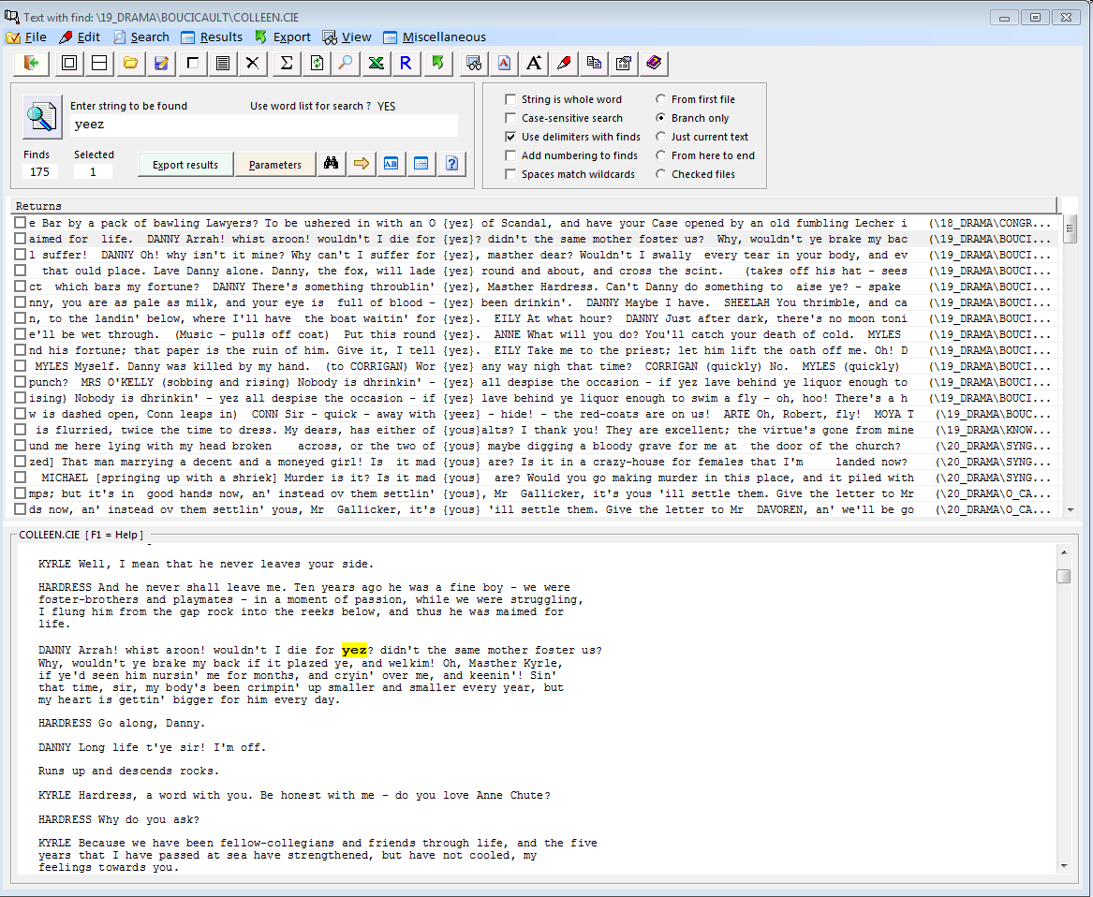
Finds for non-standard second person pronouns over the centuries in A Corpus of Irish English

Slide 11
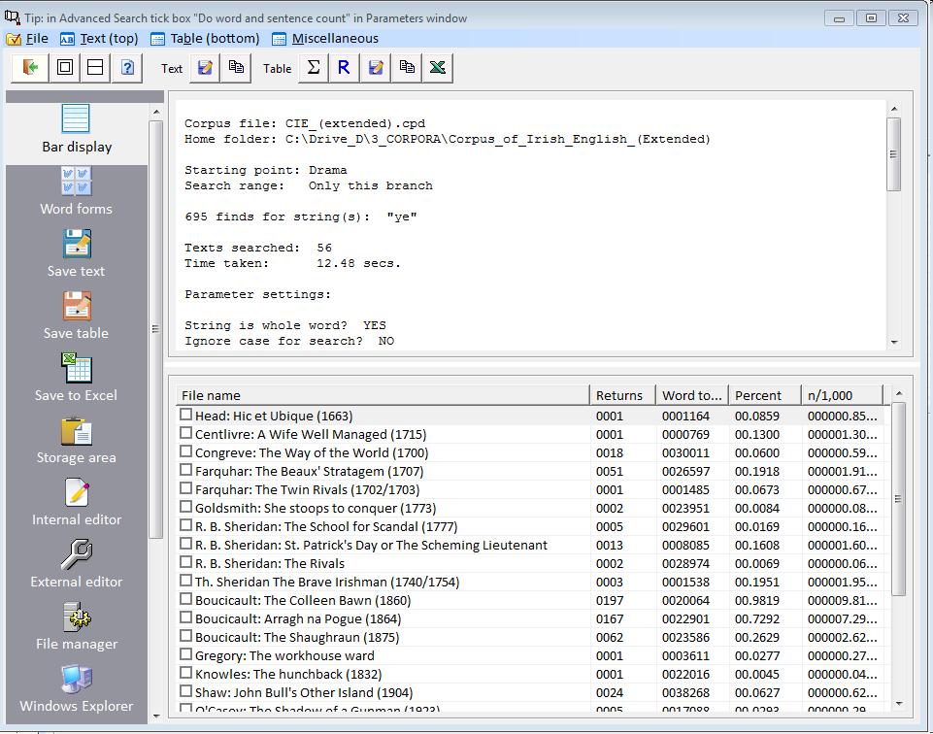
Use of supraregional (non-local) ye in A Corpus of Irish English at least from the 18th century onwards

Slide 12
Task 1: Discussion
It would appear that the second person plural forms, shown in the above corpus extracts, were formed by Irish speakers, probably due (i) to contact with Irish, which has a singular # plural distinction, and (ii) to the retention of older forms of English which distinguished between singular and plural. An interesting feature of modern Irish English is that origin (ii) seems to be the source for ye, the plural form used by supraregional Irish English speakers while origin (i) seems to be the source for the purely Irish English forms yous(e) and yeez.
Why? The answer probably lies in the nature of language contact. Here this was by adult speakers of Irish trying to learn English (in a non-prescriptive environment) from others who already knew the language better. The Irish speakers had a singular # plural distinction in their native language and would have expected this in English. On not finding it, they created plural forms by adding the plural {S} morpheme to either you, or ye, seeing as how this morpheme was, and is, the clearest marker of the plural in English, thus yielding the two alternative forms [ju:z] and [ji:z] (note {S} is realised as [z] after a vowel).

Slide 13
Task 1: Discussion (cont.)
References
Hickey, Raymond 2003. ‘Rectifying a standard deficiency. Pronominal distinctions in varieties of English’, in: Irma Taavitsainen and Andreas H. Jucker (eds), Diachronic perspectives on address term systems, Pragmatics and Beyond, New Series, Vol. 107. Amsterdam: Benjamins, pp. 345-374.
Hickey, Raymond 2024. ‘Pronouns of address in the history of Irish English’, in: Carolina P. Amador-Moreno, Dagmar Haumann and Arne Peters (eds) Digitally-assisted Historical English Linguistics. London: Routledge, pp. 110-124.

Slide 14
Task 2: The after perfective of Irish English
AFTER

Slide 15
Task 2: The after perfective of Irish English
The temporal adverb after is normally used prospectively in English, e.g. The police are after the criminal, i.e. they hope to catch him in the near future.
However, in Irish English, after is used retrospectively, e.g. They’re after [eating] their dinner, i.e. they have eaten their dinner. (verb form is optional here). This usage is very old and probably stems from the Irish language; examples can be found in the Irish version of the New Testament from 1602.
In A Corpus of Irish English examples are found from the end of the 17th century (1680s). But the twist here is that the usage is to a future perfect situation (see following screenshot).

Slide 16
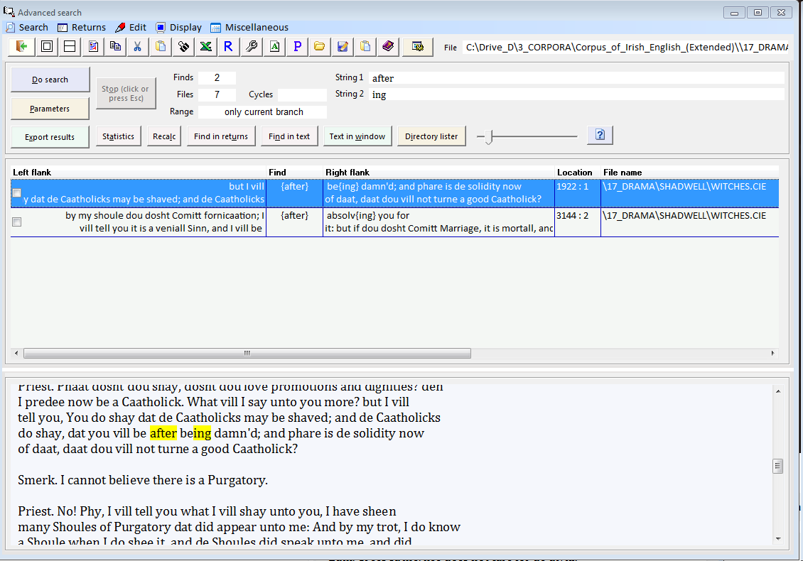
Late 17th century attestation

Slide 17
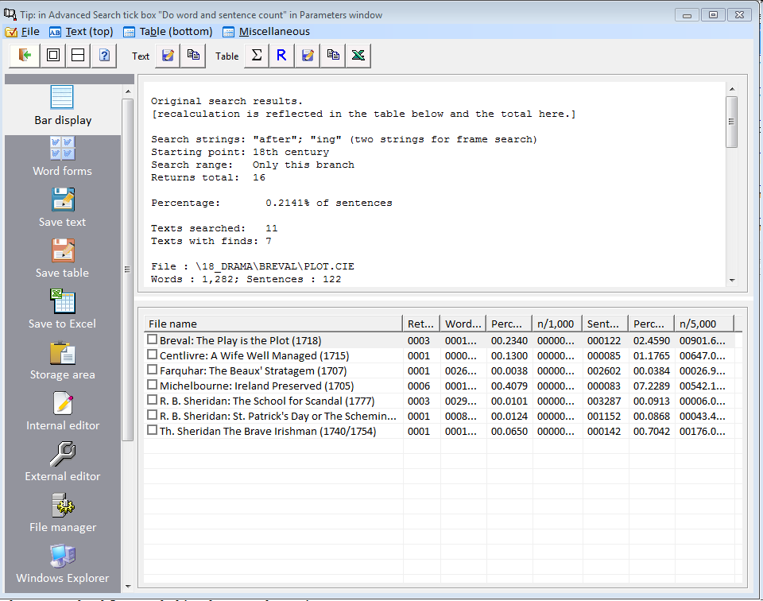
18th century attestations

Slide 18
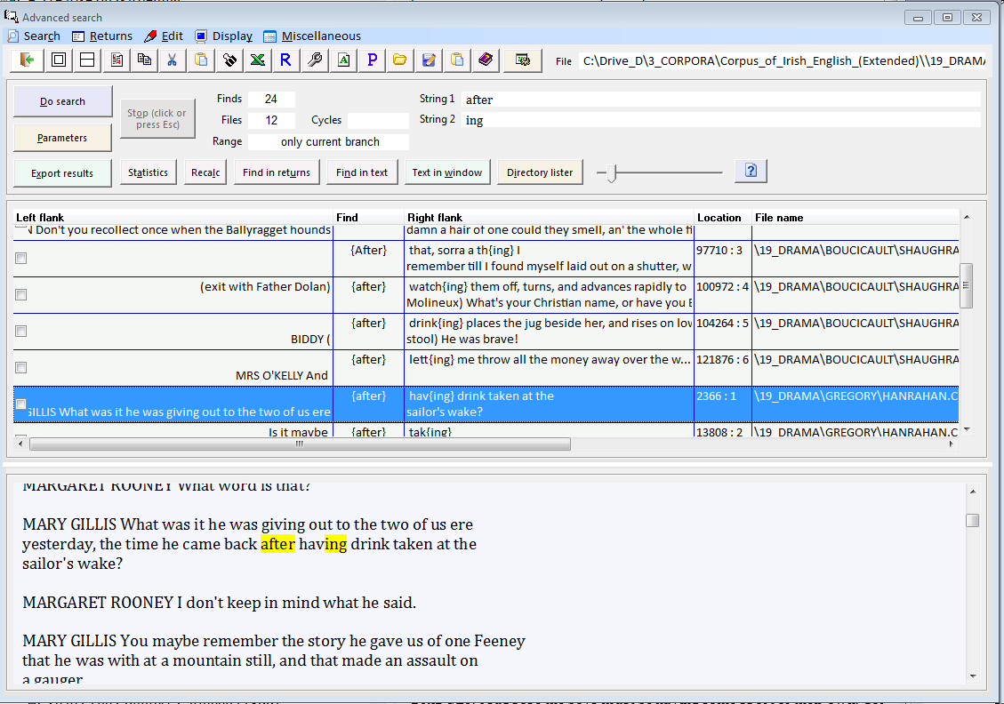
19th century attestations

Slide 19
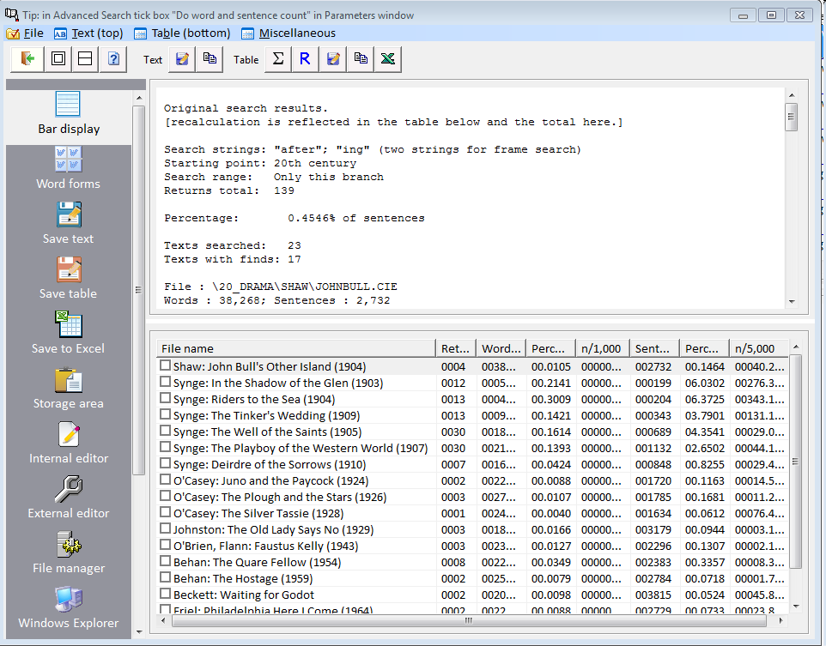
20th century attestations

Slide 20
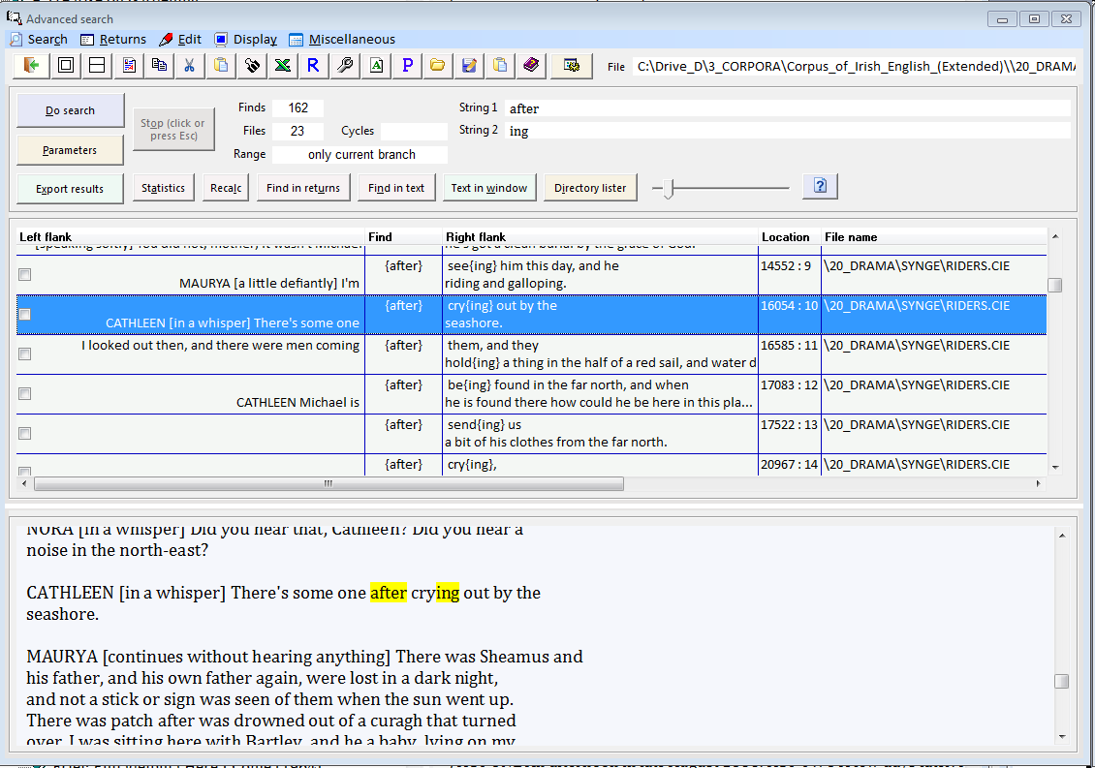
20th century attestations

Slide 21
Task 2: Discussion
The attestations, given above, show that the after perfective in Irish English increased across the centuries as it did in the Irish language, where it is very common today, e.g. Tá siad tar éis teach nua a thógáil. ‘They are after building a new house’, i.e. they have just done this.
However, the attestations also show that the initial use, with future perfect reference, declined moving into the nineteenth century. This happened in both English and Irish, which suggest a mutual cross-influence of both languages.
The corpus investigation of after usage in Irish English would imply that this perfective moved from a prospective usage (as with after in English in general) to a retrospective usage (referring to the past) where it then settled down in both languages.
More details of this development can be found in Chapter 4 of Hickey (2007), see Slide 3 above.

Slide 22
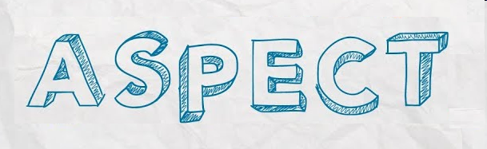
Task 3: The habitual aspect in Irish English

Slide 23
Task 3: The habitual aspect in Irish English
There are many ways in which vernacular varieties of English are different from standard varieties. One of these concerns aspect, the expression of how an action takes place (rather than when, which is the domain of tense). Vernacular aspect distinctions are well-known from many varieties, such as African American English, but also from Irish English.
For the current task the habitual aspect will be considered. This exists in the Irish language and contrasts with non-habitual usage, e.g. Bíonn sé amuigh ar an fhairrge [chuile lá] ‘He is regularly out at sea [every day]’ versus Tá sé amuigh ar an fhairrge [anois]. ‘He is out at sea [now]’.
In Irish English the habitual is expressed either by (i) the support verb do plus uninflected be, or (ii) by the form be with an inflectional -s, i.e. bes/bees [bi:z]. Note that these forms are very different from Irish bíonn in their phonetic appearance but are semantically equivalent.

Slide 24
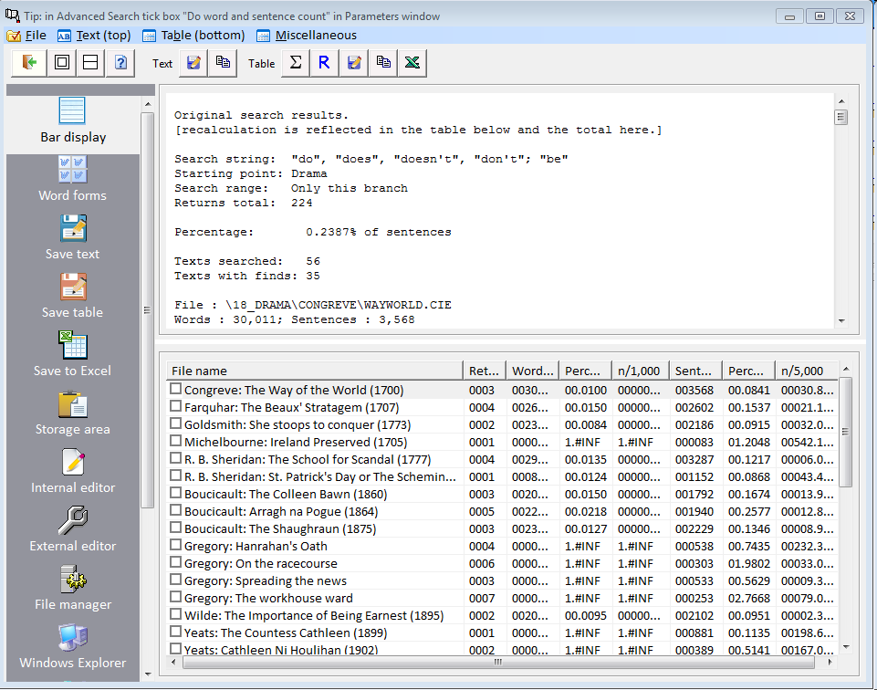
The habitual aspect, express by do + be, is widely attested in Irish English from at least the 18th century. Its distribution across authors and their works is interesting; choose Bar display on the top of the sidebar for a graphic display of the statistics.

Slide 25
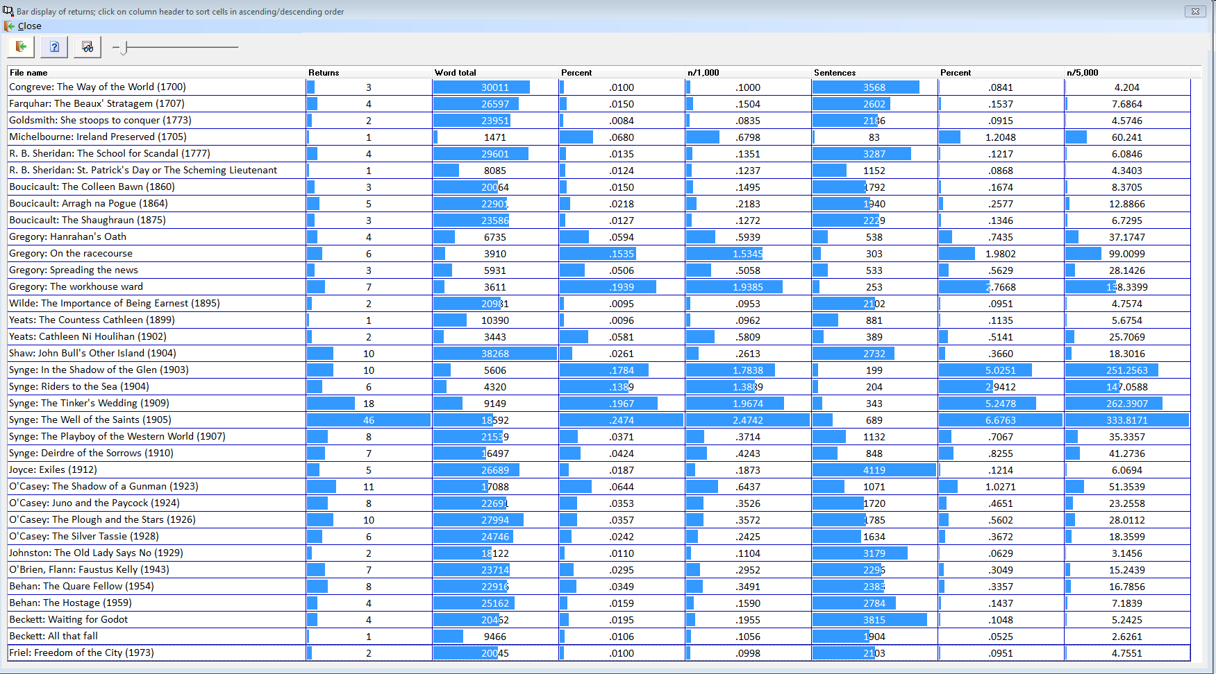
The bar display shows the values for each cell of the statistics grid as a blue bar making it easy to recognise relative values. To sort a column just click on the name of the relevant column on the top of the grid.

Slide 26
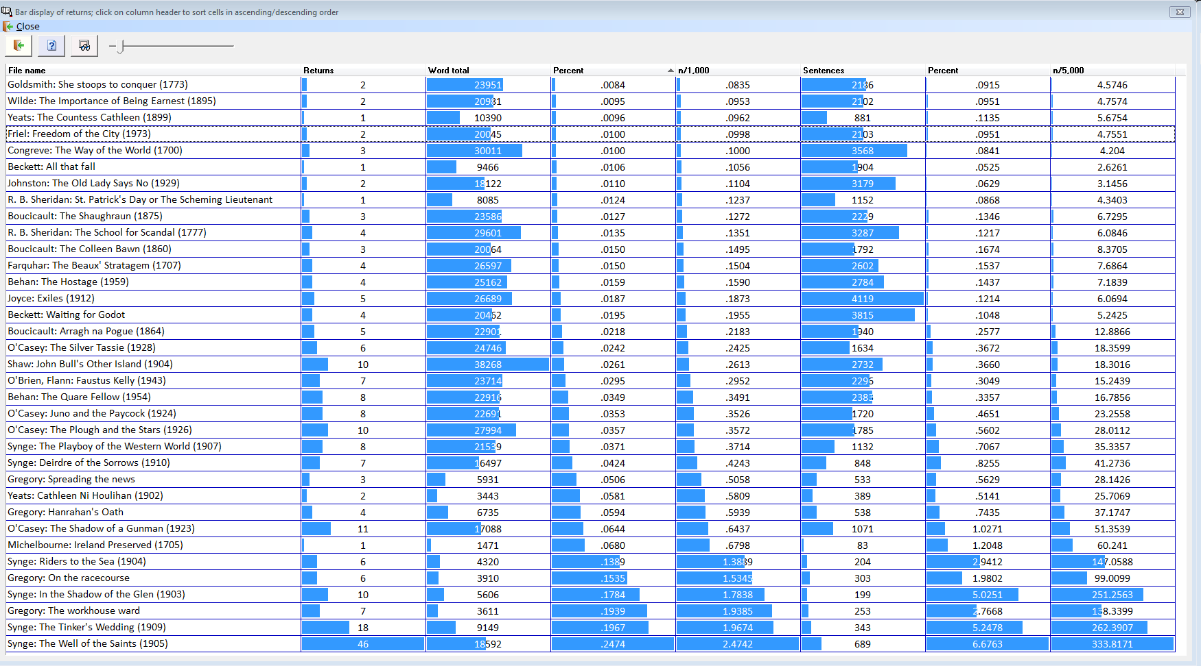
The column n/1000 shows the number of occurrences per 1000 words in each text. This allows you to see which author uses the habitual aspect most often and in what works. Notice that Synge uses this feature most often in his earlier plays.

Slide 27
Task 3: Discussion
The habitual aspect is well established in Irish English and is attested at least since the early 18th century. There are two means of expressing it: (i) with do + be or (ii) with bees. Significantly, this habitual aspect correlates with the after perfective so that we can say that both are transfer structures from Irish, i.e. that we are dealing with instances of contact-induced change which happened when Irish speakers shifted from their native language to English (during the 19th century for the majority of the population) and created equivalents to Irish grammatical structures – here: aspectual distinctions – in the process.
The issue of the habitual aspect in Irish English serves as an illustration of some of the limits of corpus linguistic investigations. It shows that a corpus of historical texts, no matter how comprehensively compiled, is only a partial snapshot of a language variety during history. Consider the following issues in this respect.
1) The use of bees for the habitual is now typical of English in Ulster (the north of Ireland). But there are no instances of this in A Corpus of Irish English, even in the prose works of William Carlton, a northern Irish writer. So it may be (i) a recent development or (ii) simply not used by authors in their literary works.

Slide 28
Task 3: Discussion
2) In the south-east of Ireland two types of habitual are found: (i) a durative habitual (of the type described above) and (ii) a punctual habitual which is used to describe a repeated action of very short duration, e.g. I gets up at seven in the morning, i.e I always get up at seven in the morning.
The punctual habitual is only attested once in A Corpus of Irish English (in a song in Sean O’Casey’s play The Silver Tassie, 1928), though it must have a history as it is found widely in the south-east of Ireland today. Furthermore, searching for this structure with computer software also leads to false results. If one searches for “I” followed immediately by a word ending in “-s” (this would catch instances like “I gets”, “I calls”, “I sees”, etc.) then the computer also returns things like “I was”, “I guess”, “I dress” as they too match the search parameters “I” + “-s”).
So one is up against the limitations of corpus searches. While it is true that one attestation for a feature is useful, one should not put too much store by it. Just remember that text corpora and software are tools to help linguists in their work. The analysis is done afterwards by weighing up and interpreting the statistics gained from working with text corpora.

Slide 29
Further possible tasks
The examples discussed in this presentation involved grammatical questions. But computer corpora can be used for other tasks, e.g. examining vocabulary to search for lexical items specific to a particular variety or period of history. Pragmatic questions could also be tackled with computer corpora, e.g. to determine how and when certain pragmatic markers arose and are distributed in a variety of language. The following two studies were done availing of text corpora to back up the claims made there.
Hickey, Raymond 2017. ‘The pragmatics of grand in Irish English’, Journal of Historical Pragmatics, 18.1: 82-102.
Hickey, Raymond 2025. ‘Anyway in Irish English. The development of a pragmatic marker’. Journal of Historical Pragmatics 25.2: 288-314.
For more information, please consult the following references, a small selection of literature on the insights gained through corpus linguistics, especially in connection with pragmatics.

Slide 30
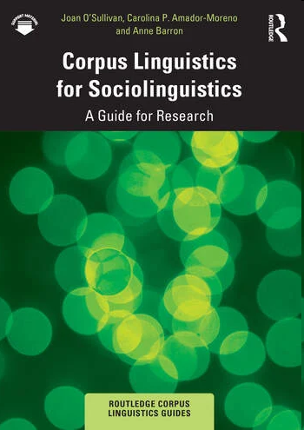
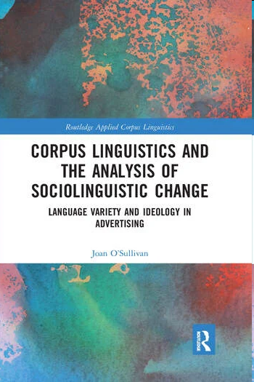
Some general references

Slide 31
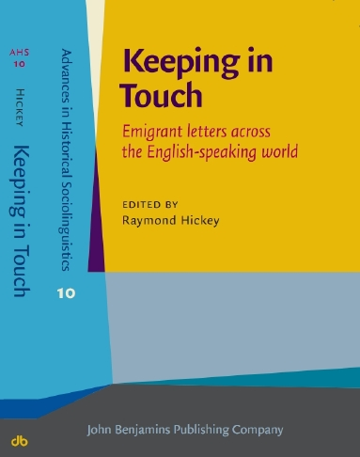
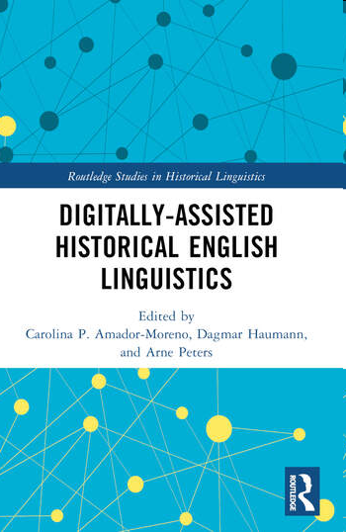
Some general references (cont.)

Slide 32
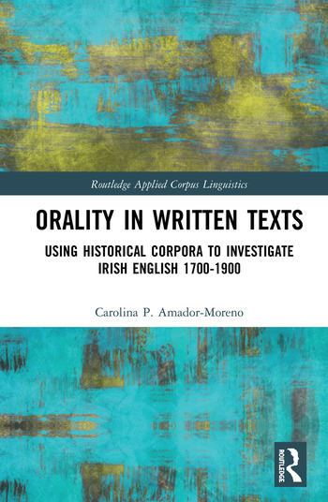
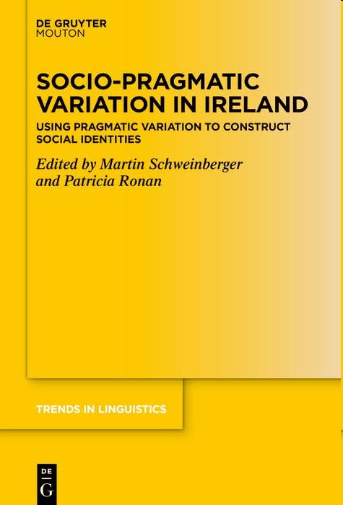
Some general references (cont.)

